Slide 1
Renewable Asset Trading
NOV 2025
*Note that the slides are old and many of the market mechanic specifications are no longer the same, but gives a understanding of how power markets operate.

Slide 2







Some names you might know
POWER PRODUCERS
AUTHORITIES
Ørsted
Vattenfall
European Energy
Eurowind
Hofor
INDUSTRY ASSOCIATIONS
BALANCE RESPONSIBLE PARTIES
Energi Danmark
Ørsted
Danske Commodities
Hofor
Vattenfall
Volue

Slide 3
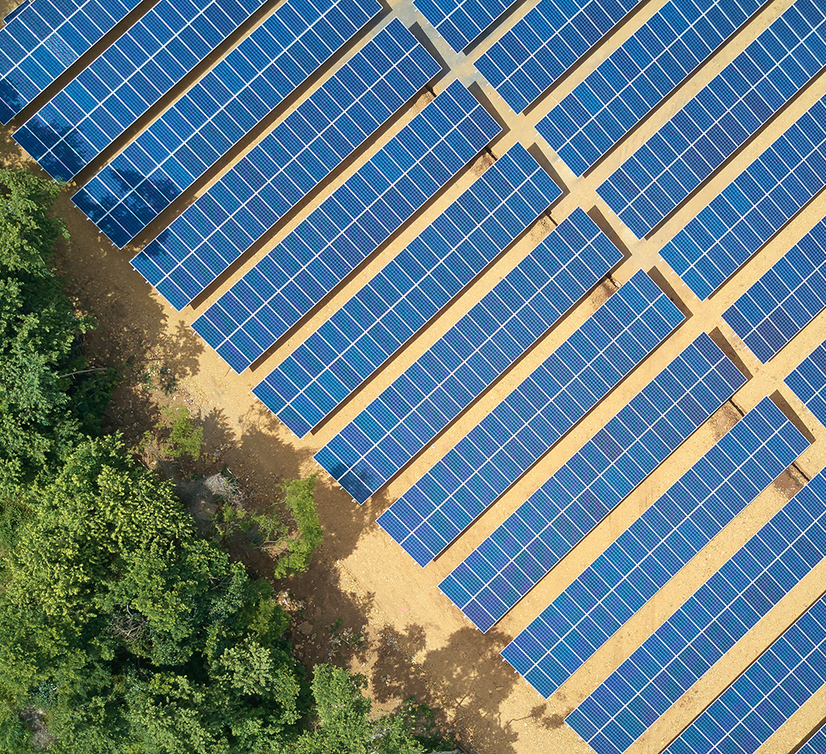
PPAs
What is a PPA?
A PPA is a contract between two parties, one which generates electricity (the seller) and one which is looking to purchase electricity (the buyer). (Wikipedia, 2023)
Why a producer enters a PPA?
Price fixing. Eliminate price volatility, deterministic cash flow, bankable project (i.e., access to lenders)
Reduce risks. Depending on the structure, the producer offload risks (e.g., profile, price, volume etc.) for a fee
Market access. The need to have a trader to be BRP (balance responsible party) and trade on the wholesale markets
Why a trader enters a PPA?
Managing the asset owners' risk for a premium. With better knowledge and access to the markets traders can manage risk for a premium
Portfolio diversification. By technology, location, profile and structure etc.

Slide 4
PPA Structures
Merchant – Trader takes on the role as BRP. Trader settles the asset owner with spot power prices and takes a fee for the risks involved.
The trader effectively guarantees spot minus fee as income for the assets power output.
Trader manges its risk through forecasting asset production and trading the short-term power markets.
As BRP the trader is responsible for volumes produced towards the TSO and is exposed towards the imbalance regulation price.
PaP Price Hedge – Trader provides a fixed price on volumes produced. This leaves the trader exposed to ”merchant” risk.
On merchant side the spot minus fee is guaranteed, so the price hedge has the risk of the difference between spot and the given fix price.
Trader manages risk trough derivatives (futures, forwards, OTC. Products) and corporate offtakers (cPPA).
Trader is exposed to Credit Risk, Price Risk, Liquidity risk, Profile Risk, and Volume Risk.

Slide 5
The Power System
Planning
Operation
Financial system
Physical system
Day-ahead spot market
Intraday market
Balancing market
Physical exchange
Settlement
Gate Closure
Management of short-term imblances
12:00 Day-1
-1 Hour
-45 min
Hour of operation
Day + (6)
Common marginal price market
Security of supply
Settlement

Slide 6
The Power System
The auction where volumes for production and consumption are submitted for the following 24 hours
Planning
Operation
Financial system
Physical system
Day-ahead spot market
Intraday market
Balancing market
Physical exchange
Settlement
Gate Closure
Management of short-term imblances
12:00 Day-1
-1 Hour
-45 min
Hour of operation
Day + (6)
Common marginal price market
Security of supply
Settlement

Slide 7

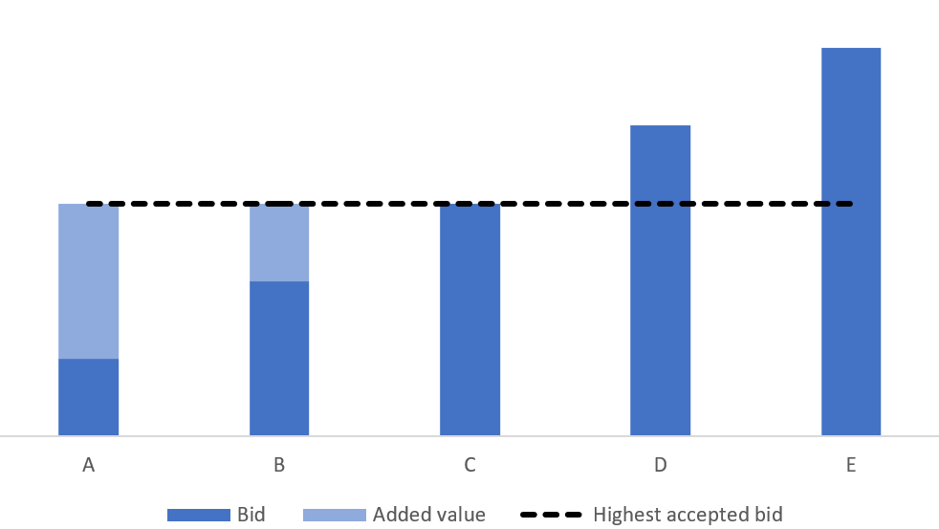
Spotmarket / Day-ahead
The spot curve looks a bit like a standard consumption curve
  Correlation between consumption and price?
New term! Auction Schemes!
Pay-as-clear
  Uniform price
  The highest accepted bid price is the price awarded to the producers and what the price to be paid by consumers
  Incentive to bid marginal price or opportunity cost
Every hour

Slide 8
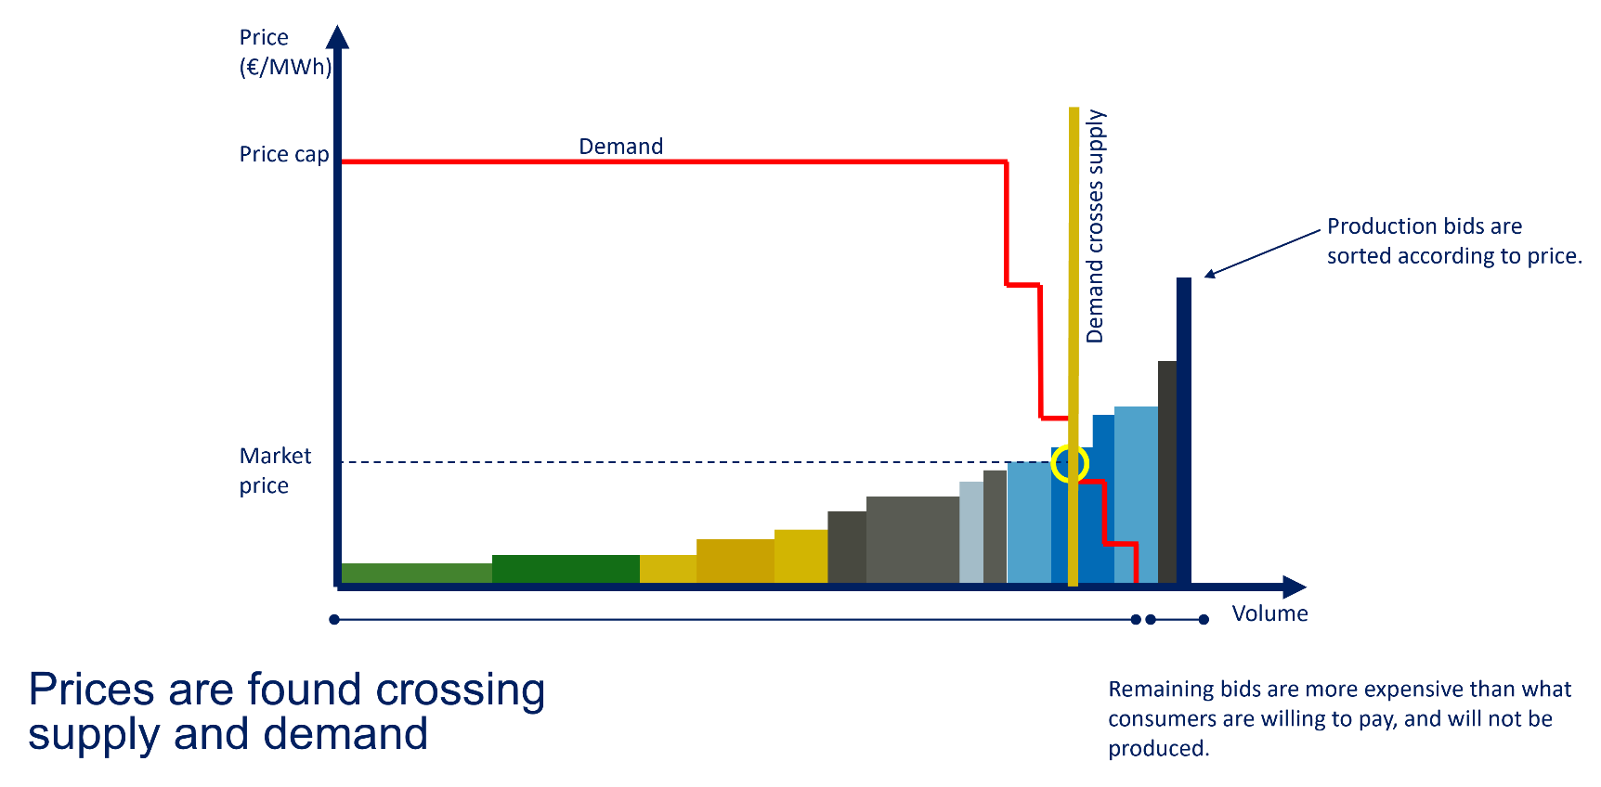
Day-ahead market
Most of the planning takes place 12-36 hours before delivery – in the Day ahead market (spot market).
Trade is shifting towards the markets closer to delivery – Intraday and balancing markets
  Difficult to predict production
    Wind
    Solar

Slide 9
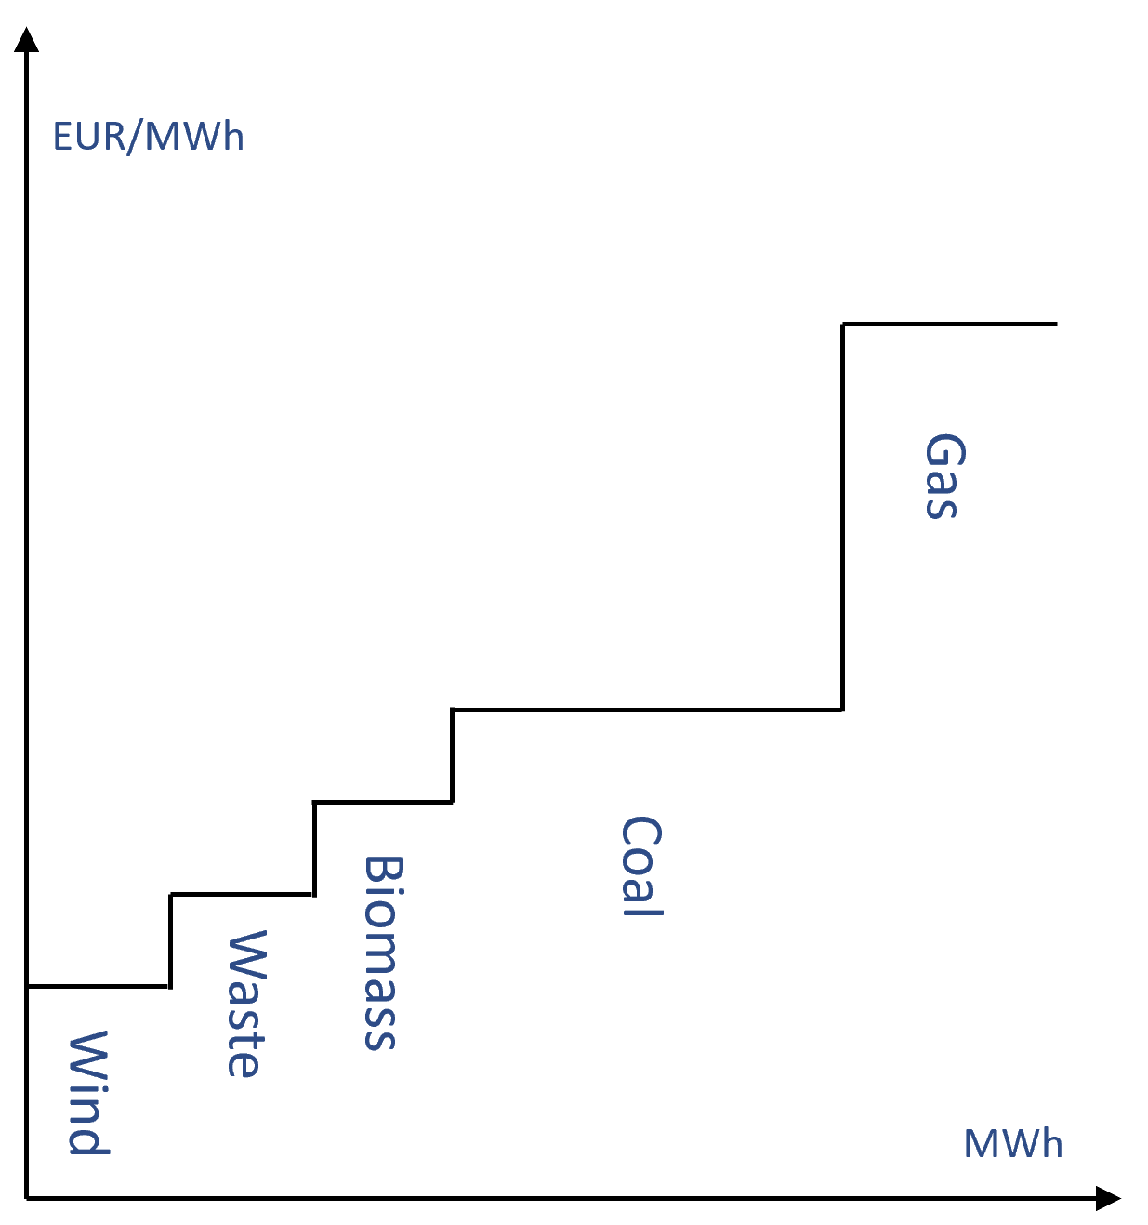
Setting the price in the Day-ahead/spot market
Dynamic market - Power prices on an hourly basis
  Varying fuel and emissions prices daily
    Gas as fuel: hourly
  Varying consumption (demand)
  Varying production from renewables
Day-ahead-price determined on the exchange e.g., Nord Pool
Balance responsible: Bid/ask setup
    Bid: Asset owner with production
    Ask: Consumers (via. Retailer and balance responsible)

Slide 10
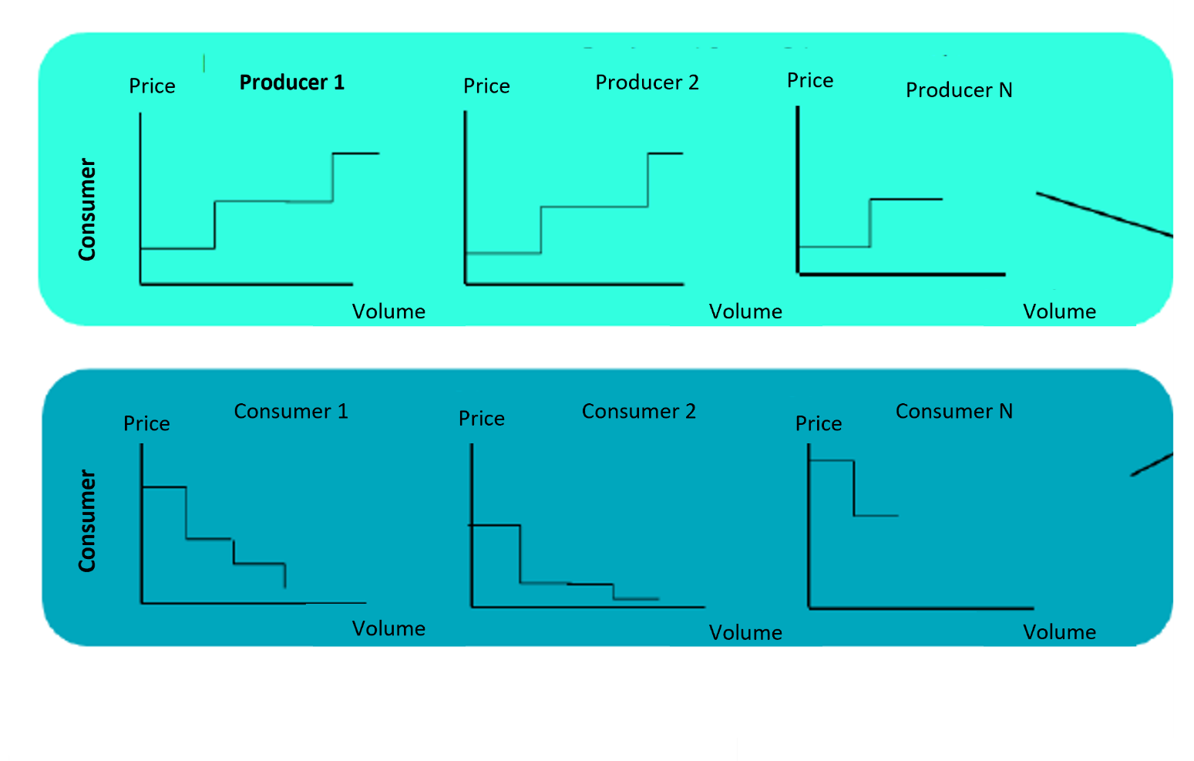
Individual Bid and ask joined
EUR/MWh
Supply
Market price
Demand
MWh

Slide 11
Bid curve and different assets
Euro/MWh
What is the marginal price?
Wind
Coal CHP
Hydro
Oil/Gas
Coal Condensing
Nuclear
0
MWh
-500

Slide 12
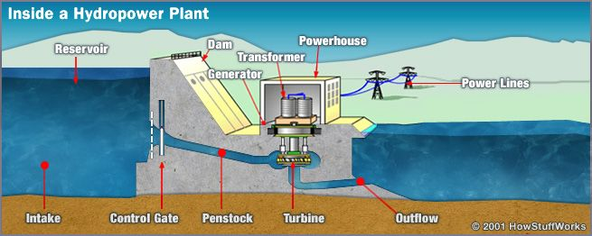
Discussion: How do hydro plants owners bid into the market?
What is the marginal price?
What is the right bidding price?
If reservoir is limited in size and no inflow is predicted?
How do you price a resource that is free but scarce?
New term: Water value

Slide 13
The Power System
The auction primarily used for managing imbalances close to the of hour operation for example in case of forecast errors or outages
Planning
Operation
Financial system
Physical system
Day-ahead spot market
Intraday market
Balancing market
Physical exchange
Settlement
Gate Closure
Management of short-term imblances
12:00 Day-1
-1 Hour
-45 min
Hour of operation
Day + (6)
Common marginal price market
Security of supply
Settlement

Slide 14
The power system - Intraday
Quick Facts about intraday
Gate open D-1 at 15.00
Gate closure: H-1 (an hour before operation)
Auction type is PAP = Pay-as-bid
Multible prices for the same hour
ENERGY INSIGHT
WHOLESALE ENERGY

Slide 15
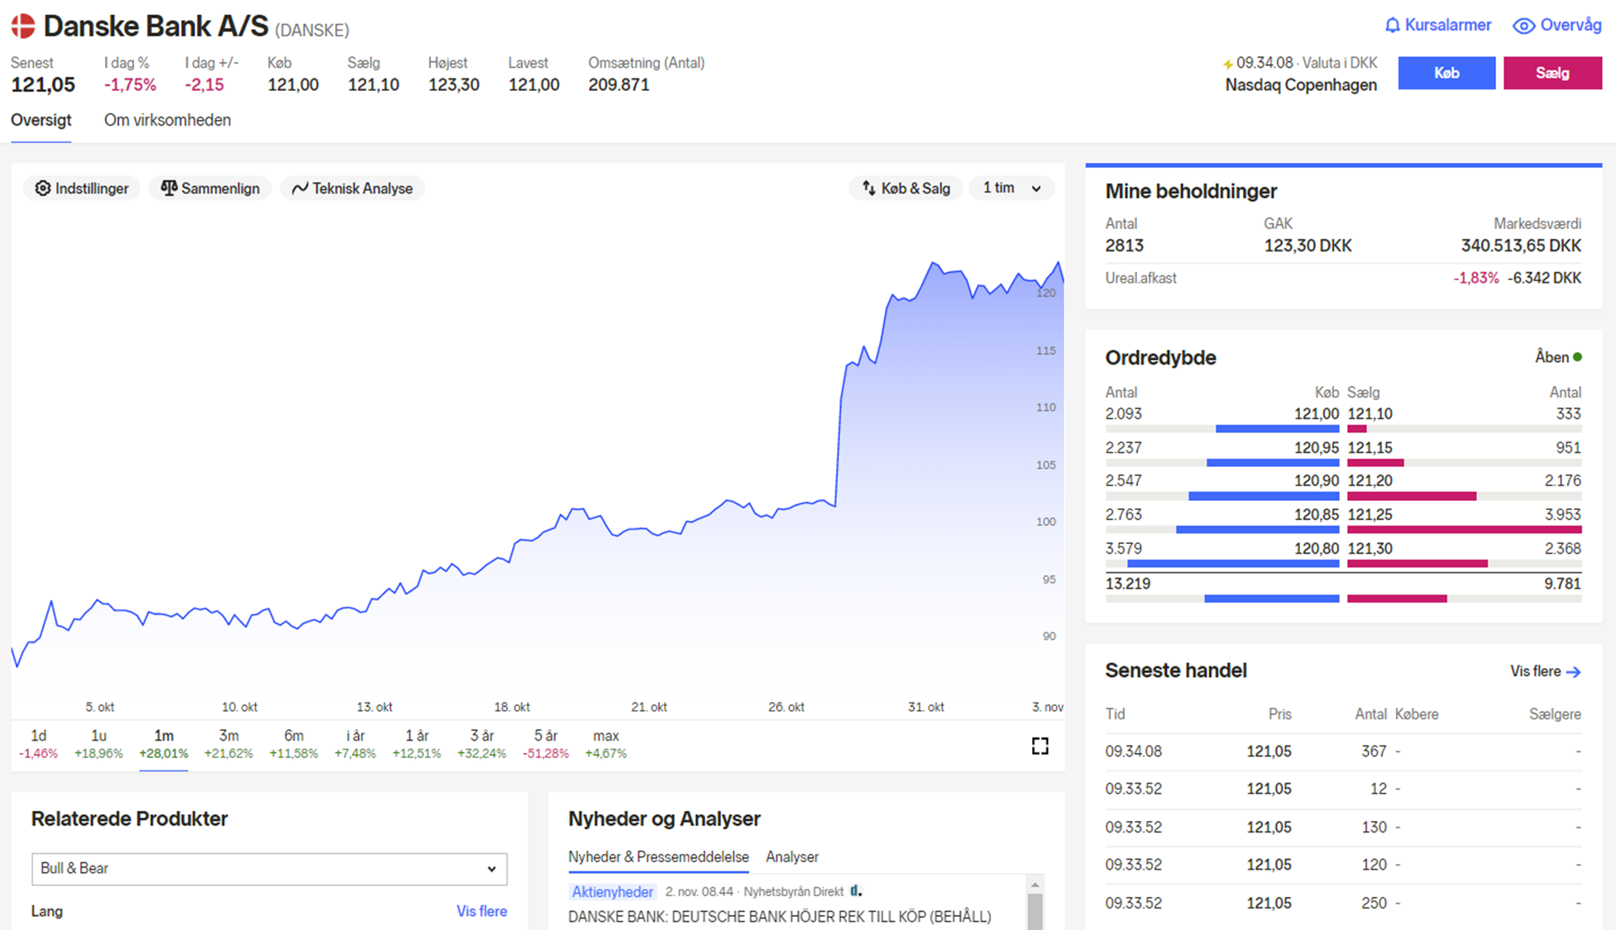
Akin to stocktrade with a time dimension
Bid
Ask
Source: nordnet.dk

Slide 16
The Power System
The market ensuring security of supply and unmanaged imbalances = The ”insurance” of the power system
Planning
Operation
Financial system
Physical system
Day-ahead spot market
Intraday market
Balancing market
Physical exchange
Settlement
Gate Closure
Management of short-term imblances
12:00 Day-1
-1 Hour
-45 min
Hour of operation
Day + (6)
Common marginal price market
Security of supply
Settlement

Slide 17
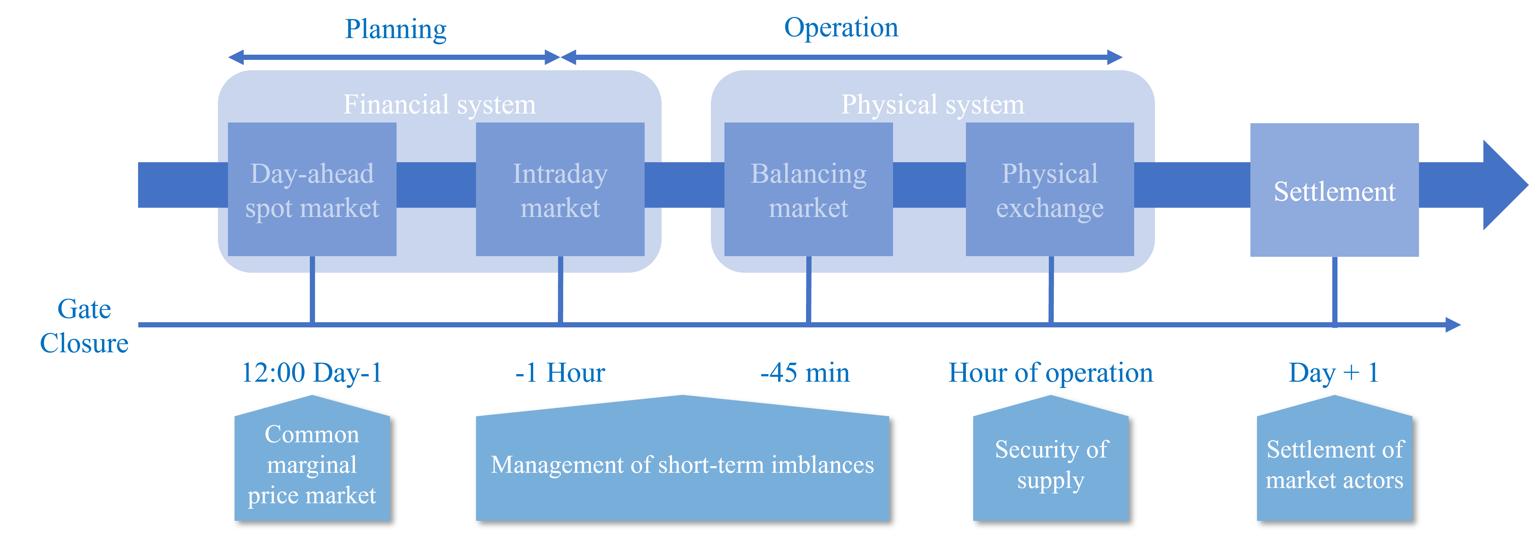
Balancing Market
The power system needs to balanced all the time:
Consumption = Production
But if something unexpected happens or it is past the intraday gate closure?
ENERGY INSIGHT
WHOLESALE ENERGY

Slide 18
Balancing Market
The power system needs to balanced all the time:
Consumption = Production
But if something unexpected happens or it is past the intraday gate closure?
What happens then?
Who has the responsability?
How do they secure the balance?
Imbalance occurs
Ancillary services / Reserves
TSO

Slide 19
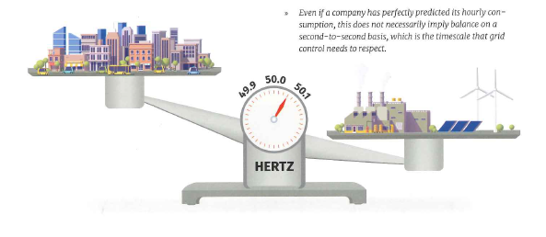
Balancing Market
New term!
Up-regulation
Down-regulation
ENERGY OPTIMISATION
ENERGY INSIGHT
WHOLESALE ENERGY

Slide 20

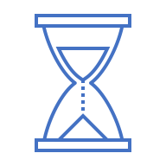



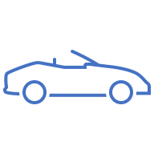



Response time | Duration | Minimum bid | Direction
0,7 - 1,3 sec | 10 sec | 0,3 MW | Up
50% in 5 sec 100% in 30 sec | 15 min. | 0,3 MW | Asymmetric
150 sec | 60 min. | 0,3 MW | Symmetric
5 min | 60 min. | 1 MW | Asymmetric
12 min | 60 min. | 5 MW | Asymmetric
Reserves in DK2, FI, NO and SE
FFR
FCR-D
FCR-N
aFRR
mFRR

Slide 21
Regulation Price Finland
New Model:
Old model:
Regulation = mFRR
Up-regulation | Down-regulation
Max(mFRR, AVG(aFRR)) | Min(mFRR, AVG(aFRR))

Slide 22
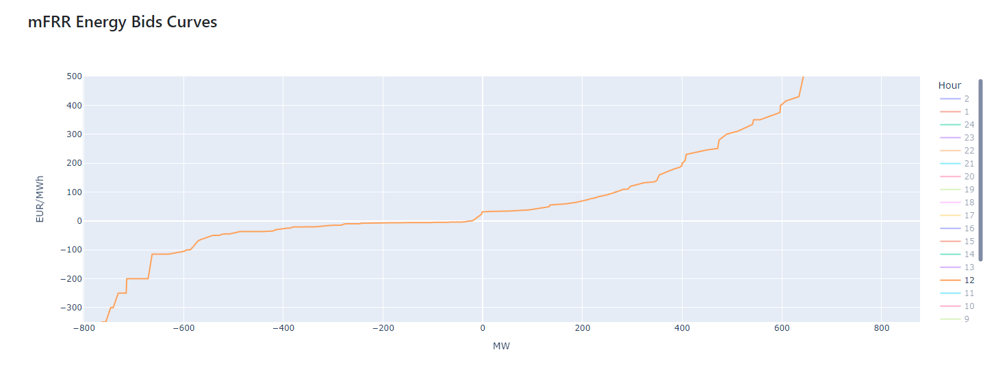
mFRR Bid Curve
Source: transparency.entsoe.eu

Slide 23
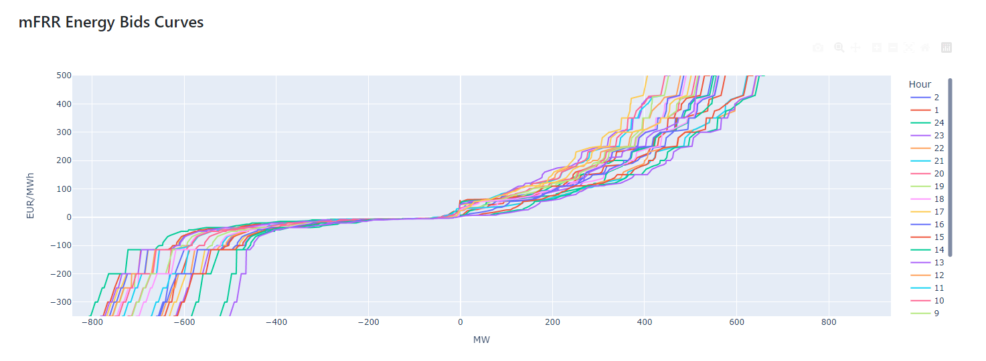
mFRR Bid Curve
Source: transparency.entsoe.eu

Slide 24
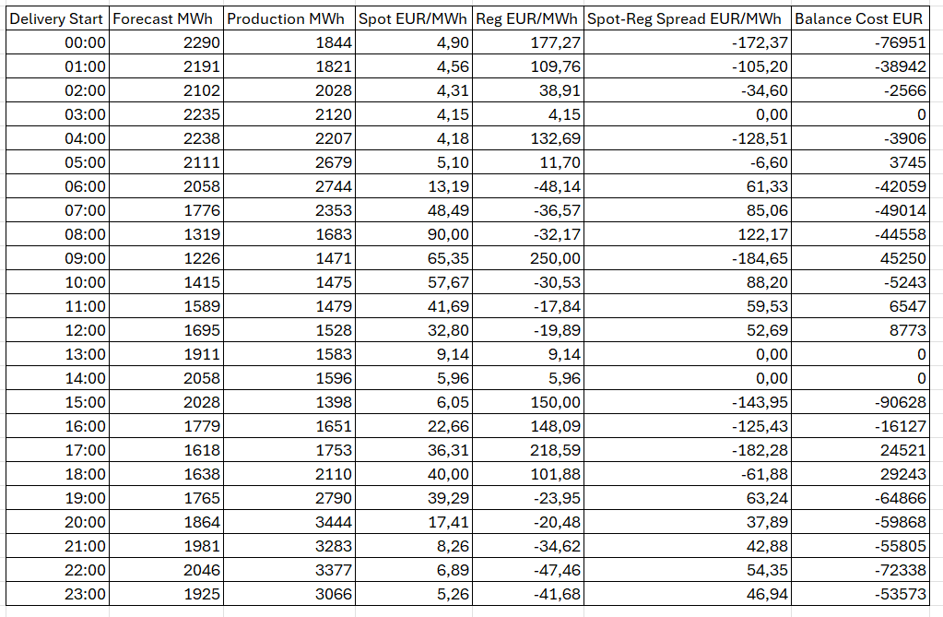
Fingrid Wind DAH forecast, FI Windproduction and market prices on 2024-09-02. Source: fingrid.fi & data.nordpoolgroup.com
Balance Costs

Slide 25
Discussion: How would you evaluate balance costs of windpark?
What causes balancing costs?
Can they be reduced?
Will they change?

Slide 26
Balance Costs
Forecast errors
Error correlation with system imbalance
Available flex and flex activation costs
Balancing regime
Trading activity

Slide 27
General Disclaimer
By viewing this presentation, the recipient agrees to be bound by the following obligations and limitations.
This presentation has been prepared by Centrica Energy Trading A/S and/or its subsidiaries (together, “Centrica”) for the exclusive use of the party/parties to whom Centrica delivers this presentation (the “Parties”). The information in this presentation has been obtained from contributors to Centrica and publicly available sources and has not been independently verified by Centrica or any of its directors, officers, employees, agents, representatives or advisers or any other person. No representation, warranty or undertaking, express or implied, is or will be given by Centrica or its directors, officers, employees and/or agents as to or in relation to the accuracy, completeness, reliability or sufficiency of the information contained in this presentation or as to the reasonableness of any assumption contained therein, and to the maximum extent permitted by law and except in the case of fraud, Centrica and each of its directors, officers, employees and agents expressly disclaim any liability which may arise from this presentation and any errors contained therein and/or omissions therefrom or from any use of the contents of this presentation. This presentation should not be regarded by the Parties as a substitute for the exercise of its own judgment and the Parties are expected to rely on their own due diligence if they wish to proceed further.
Any valuations, forecasts, estimates, opinions and projections contained herein involve elements of subjective judgment and analysis. Any opinions expressed in this material are subject to change without notice and may differ or be contrary to opinions expressed by others as a result of using different assumptions and criteria. This presentation may contain forward-looking statements. Centrica gives no undertaking and is under no obligation to update these forward-looking statements for events or circumstances that occur subsequent to the date of this presentation or to update or keep current any of the information contained herein and this presentation is not a representation by Centrica that it will do so. Any estimates or projections as to events that may occur in the future (including projections of revenue, expense and net income are based upon the best judgment of Centrica from the information provided by any contributors and publicly available information as of the date of this presentation. Any statements, estimates, projections or other pricing are accurate only as at the date of this presentation. There is no guarantee that any of these estimates or projections will be achieved. Actual results will vary from the projections and such variations may be material.
This presentation speaks as at the date hereof and in giving this presentation, no obligation is undertaken and nor is any representation or undertaking given by any person to provide the recipient with additional information or to update, revise or reaffirm the information contained in this presentation or to correct any inaccuracies therein which may become apparent.

